Slide 1



CHAPTER 1
THE HUMAN

Slide 2
Lecture Outline
Information i/o …
  visual, auditory, haptic, movement
Information stored in memory
  sensory, short-term, long-term
Information processed and applied
  reasoning, problem solving, skill, error
Emotion influences human capabilities
Each person is different

Slide 3
INFORMATION-PROCESSING SYSTEM FOR HUMAN
First Part
Information I/O

Slide 4
Human Input/Output Channels
A person’s interaction with the outside world occurs through information being received and sent: input and output.
In an interaction with a computer:
  The user receives information that is output by the computer.
  Responds by providing input to the computer.
  The user’s output becomes the computer’s input and vice versa.

Slide 5
Human Input/Output Channels (cont)
Input in the human occurs mainly through the senses.
Output through the motor control of the effectors.
There are five major senses:
  Sight
  Hearing
  Touch
  Taste
  Smell

Slide 6
Human Input/Output Channels (cont)
Only sight, hearing, and touch are the most important to HCI.
Taste and smell do not currently play a significant role in HCI.
For example, Imagine using a personal computer (PC) with a mouse and a keyboard:
  The application you are using has a graphical interface, with menus, icons and windows.
  In your interaction with this system you receive information primarily by sight, from what appears on the screen.

Slide 7
Human Input/Output Channels (cont)
However, you may also receive information by ear.
For example, the computer may ‘beep’ at you if you make a mistake or to draw attention to something, or there may be a voice commentary in a multimedia presentation.

Slide 8
Vision
Vision is the primary source of information for the average person.
• Human vision is a highly complex activity with a range of physical and perceptual limitations.
We can roughly divide visual perception into two stages:
  The physical reception of the stimulus from the outside world.
  The processing and interpretation of that stimulus.

Slide 9
First Stage: Physical Reception
Vision begins with light.
The eye is a mechanism for receiving light and transforming it into electrical energy.
  Light is reflected from objects in the world.
  image is focused upside down on the back of the eye (i.e., in retina).
  The receptors in the eye transform it into electrical signals which are passed to the brain.
  Ganglion cells (brain!) detect pattern and movement.

Slide 10
Second Stage: Processing and Interpreting
The visual perception has many aspects which are:
  Perceiving size and depth
  Perceiving brightness
  Perceiving color
How does the eye perceive size, depth and relative distances?

Slide 11
Perceiving Size and Depth
As we noted in the previous section, reflected light from the object forms an upside-down image on the retina.
The size of that image is specified as a visual angle.

Slide 12
Perceiving Size and Depth (cont)
Visual angle indicates how much of view object occupies (affected by size and distance from eye)
  if two objects are at the same distance, the larger one will have the larger visual angle.
  if two objects of the same size are placed at different distances from the eye furthest one will have the smaller visual angle.
visual acuity is ability to perceive detail (limited).

Slide 13
Perceiving Size and Depth (cont)
If we were to draw a line from the top of the object to a central point on the front of the eye and a second line from the bottom of the object to the same point.
Visual angle of the object is the angle between these two lines.

Slide 14
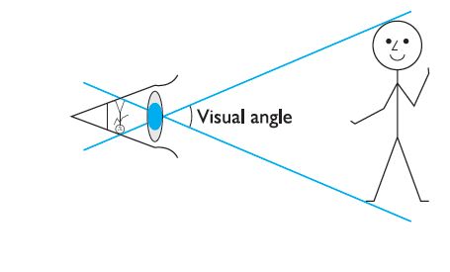
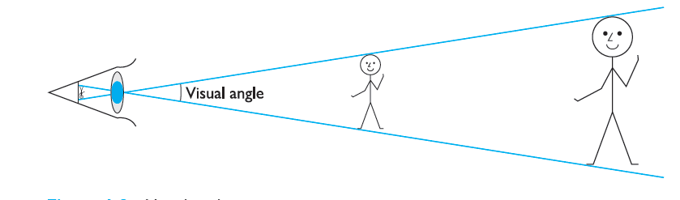
Perceiving Size and Depth (cont)
The following figures illustrate how the visual angle is calculated.

Slide 15
Exercise (1)
How does the eye perceive brightness and color?
  Send to email : olwan7do@gmail.com

Slide 16
Exercise (1): Info
Brightness
  subjective reaction to levels of light
  affected by luminance of object
  measured by just noticeable difference
  visual acuity increases with luminance as does flicker
Colour
  made up of hue, intensity, saturation
  cones sensitive to colour wavelengths
  blue acuity is lowest
  8% males and 1% females colour blind

Slide 17
Processing and Interpreting (cont)
The visual system compensates for:
  movement
  changes in luminance.
Context is used to resolve ambiguity.
Optical illusions sometimes occur due to over compensation.

Slide 18
Visual Processing
Capabilities and limitations of visual processing:
  Visual processing involves the transformation and interpretation of a complete image, from the light that is thrown onto the retina (i.e., visual processing enact the high-level of visual perception).
  Visual processing compensates for the movement of the image on the retina, which occurs as we move around and as the object which we see moves.

Slide 19

Visual Processing (cont)
Capabilities and limitations of visual processing:
  As an ability to interpret and exploit our expectations.
  Visual processing can be used to resolve ambiguity.
  For example, consider the object shown in the following figure.

Slide 20


Visual Processing (cont)
Capabilities and limitations of visual processing:
  The context in which the object appears allows our expectations to clearly disambiguate the interpretation of the object, as either a B or a 13.

Slide 21
Visual Processing (cont)
On the other side, Visual processing can also create optical illusions.
For example, consider the following Ponzo illusion figure.
the Ponzo illusion

Slide 22
Visual Processing (cont)
In this figure: the top line appears longer, owing to the distance effect.
Although both lines are the same length.
These illusions demonstrate that our perception of size is not completely reliable.

Slide 23
Reading
Several stages:
  Visual pattern perceived.
  Decoded using internal representation of language.
  Interpreted using knowledge of syntax, semantics, pragmatics.
Reading involves saccades and fixations
Perception occurs during fixations
Word shape is important to recognition
Negative contrast improves reading from computer screen

Slide 24
Hearing
Provides information about environment:
  Distances
  Directions
  Objects
  Etc
Hearing begins with vibrations in the air or sound waves.
Ear receives these vibrations and transmits them through various stages, to the auditory nerves.

Slide 25
Hearing (cont)
Physical apparatus:
  Outer Ear
  protects inner and amplifies sound.
  Middle Ear
  transmits sound waves as vibrations to inner ear.
  Inner Ear
    chemical transmitters are released and cause impulses in auditory nerve.
Humans can hear frequencies from 20Hz to 15kHz
  less accurate distinguishing high frequencies than low.

Slide 26
Touch
Provides important feedback about environment.
May be key sense for someone who is visually impaired.
Stimulus received via receptors in the skin, has three types of sensory receptor:
  Thermoreceptors
    respond to heat and cold
  Nociceptors
    respond to pain
  Mechanoreceptors
    respond to pressure (some instant, some continuous)
Some areas more sensitive than others e.g. fingers.

Slide 27
Movement
Time taken to respond to stimulus.
  reaction time + movement time
Movement time dependent on age, fitness etc.
Reaction time
  Reaction time dependent on stimulus type.
    visual ~ 200ms
    auditory ~ 150 ms
    pain ~ 700ms
Increasing reaction time decreases accuracy in the unskilled operator but not in the skilled operator.

Slide 28
Movement (cont)
Fitts' Law describes the time taken to hit a screen target:
Mt = a + b log₂(D/S + 1)
  where: a and b are empirically determined constants
  Mt is movement time
  D is Distance
  S is Size of target
Targets as large as possible
Distances as small as possible

Slide 29
INFORMATION-PROCESSING SYSTEM FOR HUMAN
Second Part
Information Stored in Memory

Slide 30
Memory
Memory is the second part of our model of the human as an information-processing system.
Indeed, much of human everyday activity relies on memory. As well as storing all human factual knowledge.
Memory contains knowledge of actions or procedures.
Memory allows human to repeat actions, to use language, and to use new information received via senses.

Slide 31
Memory
How does human memory work?
  To answer this question, we need to understand some of the capabilities and limitations of human memory.
There are three types of memory function:
  Sensory memories or sensory buffers
    Attention
  Short-term memory or working memory
    Rehearsal
  Long-term memory
Selection of stimuli governed by level of arousal.

Slide 32
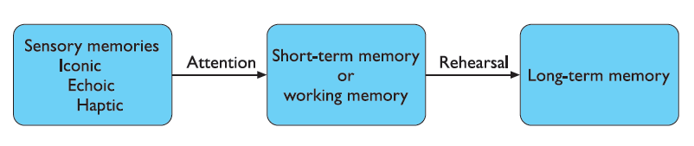
Memory
A Model for The Structure of The Memory

Slide 33
Sensory Memory
The sensory memories act as buffers for stimuli received through the senses.
There is a sensory memory exists for each sensory channel:
  iconic memory: visual stimuli
    is the sensory memory for visual stimuli
  echoic memory: aural stimuli
    is the sensory memory for aural stimuli
  haptic memory: tactile stimuli
    is the sensory memory for touch

Slide 34
Sensory Memory
For examples
  “sparkler” trail
  stereo sound
  continuously overwritten
We can demonstrate the existence of iconic memory by moving a finger in front of the eye.
  Can you see it in more than one place at once?
    This indicates a persistence of the image after the stimulus has been removed.

Slide 35
Sensory Memory
Information is passed from sensory memory into short-term memory by attention, thereby filtering the stimuli to only those which are of interest at a given time.
Attention is the concentration of the mind on one out of a number of competing stimuli or thoughts.
It is clear that we are able to focus our attention selectively, choosing to attend to one thing rather than another.
  This is due to the limited capacity of our sensory and mental processes.

Slide 36
Short-Term Memory (STM)
Short-term memory acts as a ‘scratch-pad’ for temporary recall (i.e., it is used to store information which is only required fleetingly).
Also, short-term memory is:
  rapid access
  rapid decay
  limited capacity

Slide 37
Examples
212348278493202
0121 414 2626
HEC ATR ANU PTH ETR EET

Slide 38
Examples
Calculate the multiplication 35 × 6 in your head. The chances are that you will have done this calculation in stages:
  Perhaps 5 × 6 and then 30 × 6 and added the results.
  May be have used the fact that 2 × 3 = 6 and calculated 2 × 35 = 70 followed by 3 × 70.
To perform calculations such as this we need to store the intermediate stages for use later.

Slide 39
Short-Term Memory (STM)
Rapid Access ~ 70 ms
  Short-term memory can be accessed rapidly, in the order of 70 ms.
Rapid Decay ~ 200 ms
  Short-term memory also decays rapidly, meaning that information can only be held there temporarily, in the order of 200 ms.
Limited Capacity ~ 7±2 Chunks
  Short-term memory also has a limited capacity.

Slide 40
Short-Term Memory (STM)-
Limited Capacity
Short-term memory also has a limited capacity.
There are two basic methods for measuring memory capacity:
  The first, involves determining the length of a sequence which can be remembered in order.
  The second, allows items to be freely recalled in any order.
In 1956, Miller established experiments which indicate that the average person can remember 7 ± 2 digits.
For example, try to Look at the following number sequence: 265397620853

Slide 41
Short-Term Memory (STM)-
Limited Capacity
Now write down as much of the sequence as you can remember.
  Did you get it all right?
  If not, how many digits could you remember?
  If you remembered between five and nine digits your digit span is average.
Now try the following sequence:
44 113 245 8920
  Did you recall that more easily?
  Here the digits are grouped or chunked.
  A generalization of the 7 ± 2 rule is that we can remember 7 ± 2 chunks of information.
Therefore, chunking information can increase the short-term memory capacity.

Slide 42
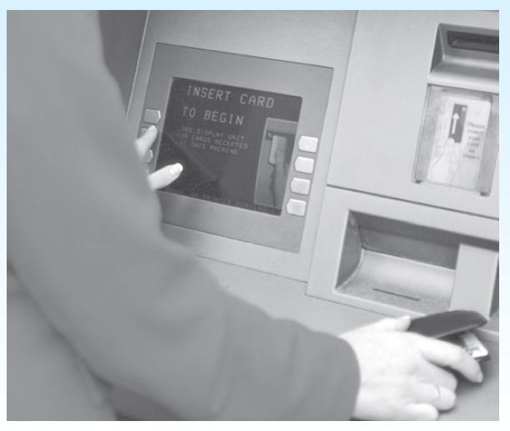
Short-Term Memory (STM)-
Design Focus
Human minds have a tendency to flush short-term memory in order to get on with the next job.
  Early automatic teller machines (ATMs) gave the customer money before returning their bank card.
  On receiving the money the customer would reach closure and hence often forget to take the card.
  Modern ATMs return the card first!

Slide 43
Short-Term Memory (STM)-
Design Focus
We noted the general rule that people can hold 7 ± 2 items or chunks of information in short-term memory.
It is a principle that people tend to remember but it can be misapplied.
The 7 ± 2 rule would apply in graphic user interfaces.
For example, It is often suggested that this means that lists, menus and other groups of items should be designed to be no more than 7 items long.
  But use of menus and lists of course has little to do with short-term memory.
  They are available in the environment as cues and so do not need to be remembered.

Slide 44
Short-Term Memory (STM)-
Design Focus
On the other hand the 7 ± 2 rule would apply in command line interfaces.
For example, Imagine a scenario where a UNIX user looks up a command in the manual:
  Perhaps the command has a number of parameters of options, to be applied in a particular order, and it is going to be applied to several files that have long path names.
  The user then has to hold the command, its parameters and the file path names in short term memory while he types them in.
  Here we could say that the task may cause problems if the number of items or chunks in the command line string is more than 7.

Slide 45
Long-Term Memory (LTM)
Long-term memory is the store of factual information, experiential knowledge, and procedural rules of behavior (i. e., everything that we ‘know’).
Long-term memory is repository for all our knowledge.
  slow access ~ 1/10 second
  slow decay, if any
  huge or unlimited capacity

Slide 46
Long-Term Memory (LTM)
Long-term memory differs from short-term memory in a number of significant ways. These ways are:
  It has a huge capacity, if not unlimited.
  It has a relatively slow access time of approximately a tenth of a second (1/10).
  Forgetting occurs more slowly in long-term memory. Unlike working memory there is little decay:
    long-term recall after minutes is the same as that after hours or days.
Information is placed there (in long-term memory) from working memory through rehearsal

Slide 47
Long-Term Memory (LTM)
Structure
Long-term memory have two types:
  Episodic memory
    Episodic memory is represents our memory of events and experiences in a serial form.
  Semantic memory
    Semantic memory is a structured record of facts, concepts and skills that we have acquired.
  Semantic LTM derived from episodic LTM
    The information in semantic memory is derived from that in our episodic memory, (such that we can learn new facts or concepts from our experiences).

Slide 48
Long-Term Memory (cont.)
Structure
Semantic memory is structured in some way to:
  Provides access to information.
  Represents relationships between pieces of information.
  Provides inference.

Slide 49
Long-Term Memory (cont.)
Structure Model
One model for the way in which semantic memory is structured is as a network.
Items are associated to each other in classes, and may inherit attributes from parent classes. This model is known as a semantic network.
Model: semantic network
  Inheritance – child nodes inherit properties of parent nodes.
  Relationships between piece of information explicit.
  Supports inference through inheritance.

Slide 50

Long-Term Memory (cont.)
Structure Model
Fore example, the knowledge about dogs may be stored in a network such as the following figure.

Slide 51
Long-Term Memory (cont.)
Models of LTM - Frames
There are A number of other memory structures (such as frames and scripts)
Frames and scripts organize information into data structures.
Slots in these structures allow attribute values to be added.
Frame slots may contain default, fixed or variable information.
  A frame is instantiated when the slots are filled with appropriate values.
See the following figure.

Slide 52
Long-Term Memory (cont.)
Models of LTM - Frames
DOG
Fixed
legs: 4
Default
diet: carniverous
sound: bark
Variable
size:
colour
COLLIE
Fixed
breed of: DOG
type: sheepdog
Default
size: 65 cm
Variable
colour
Figure : Frame-based Representation of Knowledge

Slide 53
Long-Term Memory (cont.)
Models of LTM - Scripts
-
Model of stereotypical information required to interpret situation
Script has elements that can be instantiated with values for context
Script for a visit to the vet
Entry conditions: dog ill
vet open
owner has money
Result: dog better
owner poorer
vet richer
Props: examination table
medicine
instruments
Roles: vet examines
diagnoses
treats
owner brings dog in
pays
takes dog out
Scenes: arriving at reception
waiting in room
examination
paying
Tracks: dog needs medicine
dog needs operation

Slide 54
Models of LTM - Production rules
Representation of procedural knowledge.
Condition/action rules
  If condition is matched
  Then use rule to determine action.
IF dog is wagging tail
THEN pat dog
IF dog is growling
THEN run away

Slide 55
LTM - Storage of information
Rehearsal
  Information moves from STM to LTM
Total time hypothesis
  Amount retained proportional to rehearsal time
Distribution of practice effect
  Optimized by spreading learning over time
Structure, meaning and familiarity
  Information easier to remember

Slide 56
LTM - Forgetting
Decay
  Information is lost gradually but very slowly
Interference
  New information replaces old (retroactive interference)
  Old may interfere with new (proactive inhibition )
So may not forget at all memory is selective …

Slide 57
LTM - retrieval
Recall
  Information reproduced from memory can be assisted by cues, e.g. categories, imagery
Recognition
  Information gives knowledge that it has been seen before
  less complex than recall - information is cue

Slide 58
INFORMATION-PROCESSING SYSTEM FOR HUMAN
Third Part
Information Processed and Applied
(Reasoning, Problem Solving, Skill, Error)

Slide 59
Thinking
Reasoning
  Deduction
  Induction
  Abduction
Problem solving
Skill
Error

Slide 60
Deductive Reasoning
Deduction is derive logically necessary conclusion from given premises.
Example:
  If it is Friday then she will go to work
  It is Friday
  Therefore she will go to work.
Logical conclusion not necessarily true:
Example:
  If it is raining then the ground is dry
  It is raining
  Therefore the ground is dry

Slide 61
Deduction (cont.)
When truth and logical validity clash …
Example:
  Some people are babies
  Some babies cry
Inference - Some people cry
Correct?
People bring world knowledge to bear

Slide 62
Inductive Reasoning
Induction is generalize from cases seen to cases unseen.
Example:
  all elephants we have seen have trunks
  therefore all elephants have trunks.
Unreliable:
  can only prove false not true
… but useful!
Humans not good at using negative evidence
  e.g. Wason's cards.

Slide 63
Wason's Cards
7 E 4 K
If a card has a vowel on one side it has an even number on the other
Is this true?
How many cards do you need to turn over to find out?
…. and which cards?

Slide 64
Abductive Reasoning
Abduction is reasoning from event to cause
Example:
  Sam drives fast when drunk.
  If I see Sam driving fast, assume drunk.
Unreliable:
  Can lead to false explanations

Slide 65
Problem Solving
Problem solving is process of finding solution to unfamiliar task using knowledge.
Several theories:
  Gestalt theory
    Problem solving both productive and reproductive.
  Problem space theory
    problem space comprises problem states (generating states using legal operators).
    largely applied to problem solving in well-defined areas "e.g. puzzles".

Slide 66
Errors and mental models
Types of error:
  Slips
    The right intention, but failed to do it right.
    Causes: poor physical skill and inattention etc.
    Change to aspect of skilled behaviour can cause slip.
  Mistakes
    The wrong intention.
    Cause: incorrect understanding.
      humans create mental models to explain behaviour.
      if wrong (different from actual system) errors can occur.

Slide 67
INFORMATION-PROCESSING SYSTEM FOR HUMAN
Fourth Part
Emotion Influences Human Capabilities

Slide 68
Emotion
Various theories of how emotion works:
  Emotion is our interpretation of a physiological response to a stimuli(James-Lange).
  Emotion is a psychological response to a stimuli (cannon).
  Emotion is the result of our evaluation of our physiological responses, in the light of the whole situation we are in (schacter-singer).
Emotion clearly involves both cognitive and physical responses to stimuli.

Slide 69
Emotion (cont.)
The biological response to physical stimuli is called affect.
Affect influences how we respond to situations
  positive → creative problem solving
  negative → narrow thinking
  “Negative affect can make it harder to do even easy tasks; positive affect can make it easier to do difficult tasks”
        (Donald Norman)

Slide 70
Emotion (cont.)
Implications for interface design:
  Stress
    Will increase the difficulty of problem solving
  Relaxed users
    will be more forgiving of shortcomings in design
  Aesthetically pleasing and rewarding interfaces
    will increase positive affect

Slide 71
Individual differences
Long term
  Sex
  physical
  intellectual abilities
Short term
  effect of stress
  effect of fatigue
Changing
  age
Ask yourself:
will design decision exclude section of user population?

Slide 72
Psychology and the Design of Interactive System
Some direct applications
  e.g. blue acuity is poor
  ⇒ blue should not be used for important detail
However, correct application generally requires:
  understanding of context in psychology.
  understanding of particular experimental conditions.

Slide 73



